Slide 1
Using the re-engineered Discharge toolkit to prevent 60-day readmissions
Jessica Symmes DNP, RN
Notes:
Hello, and welcome to the final project defense presentation of Jessica Symmes. Thank you for joining to learn more about Using the re-engineered Discharge toolkit to prevent 60-day readmissions implemented at an urban hospital in Arizona. Jessica implemented the Agency for Healthcare Research and Quality’s (AHRQ) Re-engineered Discharge Toolkit to impact 60-Day readmission rates. As a reminder, please stay on mute until the end of the presentation. There will be time for questions and answers at the end of the presentation. If you think of questions during the presentation, feel free to type your questions in the chat box and we will answer them at the end of the presentation. Jessica, please start your presentation.

Slide 2
Background of the project
Patient readmissions have a negative impact on patient outcomes (AHRQ, 2020)
The project site currently monitoring readmissions
Project site rate: 15.7% (Project site, 2022)
National rate: 14% (Arizona Department of Health Services, 2021)
Staff at project site report many barriers leading to readmission
A SWOT analysis was conducted to determine internal and external factors, such as strengths, weaknesses, opportunities, and threats, that would potentially impact the project’s needs and success.
Notes:
Readmitted patients have poorer outcomes, including higher mortality rates, higher risk for adverse events, and lower patient experience scores (Wang et al., 22). Current research indicates that the main barriers to a successful discharge include a lack of interdisciplinary care, gaps in communication, and poor patient health literacy (AHRQ, 2020). At the project site, the mean hospital readmission rate was 15.7% which was slightly higher than the national rate of 14% (Arizona Department of Health Services, 2021). The site was actively trying to decrease readmission rates. The staff on the target unit reported that miscommunication in discharge planning, poor health literacy, and lack of compliance were the main reasons for readmissions among patients.
An organizational needs assessment was performed to identify the strengths, weaknesses, opportunities, and threats that would impact a quality improvement project. Strengths at the site included well-established interdisciplinary communication, a solid understanding of teamwork between staff, and receptiveness to change. Weaknesses included patient noncompliance, poor staffing ratios, and nurse burnout. The opportunities that followed the successful implementation of the toolkit included improvements in staff communication, increased patient readiness for discharge, and an improvement in patient outcomes related to adverse events. Potential threats were resistance to change and misconceptions that the project would increase workload. Including staff in the project planning processing and collecting real time feedback from the change agents helped to prevent these barriers.
Overall, the opportunity for patient benefit and organizational need were two driving reasons for this project's implementation.

Slide 3
Synthesis of literature
Search strategy
Scholarly databases
Peer-reviewed, primary and secondary articles
Change recommendation
Agency for Healthcare Research and Quality (AHRQ) Re-Engineered (RED) Toolkit
Yidom et al. (2018) found within a randomized controlled trial that the use of the RED toolkit effectively decreases readmissions.
Notes:
There were numerous methods and filters applied to the process of locating research supporting the RED Toolkit interventions. Numerous databases, including CINAHL, EBSCO, PubMed, and Science Direct, were utilized to find relevant scholarly literature. The search was narrowed to peer-reviewed, primary research articles with the full text available. The articles had to be published in 2017 or later and be available in the English language. Keywords, including AHRQ, discharge, readmission, and education, were employed to find articles related to the chosen intervention. After locating five primary research studies, the search was broadened to include secondary studies.
The change recommendation for this project was to use The Agency for Healthcare Research and Quality (AHRQ) Re-engineered Discharge (RED) Toolkit within the discharge process to decrease readmission rates. Previously, the implementation site provided discharge paperwork and nurse-driven education. The use of this toolkit enhanced the discharge process by increasing interdisciplinary efforts and patient participation in transitional planning. The RED toolkit consists of multiple components that help to prepare the patient post hospitalization. The 12 components of the RED toolkit include: (1) ascertain the need for language assistance, (2) make follow up appointments, (3) plan for review of outstanding lab results, (4) organize post discharge outpatient services, (5) complete medication reconciliation, (6) utilize national guidelines in discharge planning, (7) teach the patient using a written discharge plan, (8) educate the patient about their diagnosis, (9) review with the patient what do to if a problem arises, (10) use teach back to assess understanding, (11) collaborate with clinicians accepting care of the patient, (12) and provide telephone reinforcement of the discharge plan (AHRQ, 2020). This project used the first 11 components in project implementation. Follow-up phone calls were excluded due to feasibility and staffing at the site.
The strength of the body of evidence provided through the literature review is best measured through quality, quantity, and consistency. Quality of research is evident in that all of the selected research was peer-reviewed and from a scholarly journal. The use of 15 articles demonstrating the effectiveness of the RED Toolkit provides ample data to support the intervention. The articles consistently provided evidence that the toolkit leads to a decrease in readmission rates and an improvement in patient outcomes. Overall, this toolkit proved to be continually effective at providing positive patient outcomes, and it was anticipated that it would be a successful tool within this implementation site.
The foundational research for this project was completed by Yiadom et al. (2018), who conducted a randomized control trial to evaluate the effectiveness of an innovative transitional care program in improving discharge readiness, transitional care quality, health services utilization, and patient satisfaction. The researchers sampled 220 patients; the intervention group received a transitional care intervention in alignment with the RED Toolkit, including a risk assessment for early readmission, health education from admission to pre-discharge, and individualized discharge planning (Yiadom et al., 2018). The researchers monitored 30-day readmission rates over six months. The intervention group showed significantly better discharge readiness and a 10% lower readmission rate (p = 0.033) (Yiadom et al., 2018). This article provided evidence that the standardized transitional care planning guided by the RED Toolkit decreases readmission rates and improves patients’ readiness for discharge.

Slide 4
Evidence-Based Practice Question
To what degree will the implementation of the AHRQ RED Toolkit impact 60-day readmission rates among adult medical surgical patients in an urban hospital in Arizona?
Notes:
The focus of this project was on decreasing readmission rates with the use of the RED Toolkit. The following clinical question was developed from the literature to direct this project: To what degree will the implementation of the AHRQ RED Toolkit impact 60-day readmission rates among adult medical surgical patients in an urban hospital in Arizona? The main purpose of this toolkit is to improve the discharge process, facilitate throughput, and decrease hospital readmissions (AHRQ, 2020). Research on the implementation of the RED Toolkit has demonstrated that this intervention helps improve clinical outcomes. This project included the implementation of this toolkit on the adult acute care medical surgical population. At the implementation site, there was an increase in readmissions among this patient group.
This project contributed to solving hospital readmissions because increasing discharge education aids in the process of the hospital to home transition. This toolkit encompasses numerous components that are common barriers leading to readmission (AHRQ, 2020). By approaching these barriers early in patient discharge planning, the likelihood of readmission decreases.

Slide 5
Theoretical framework
Nursing theory
Dorothea Orem’s Self-Care Deficit Theory
Tenets: independence, education, & support (Orem, 1971).
RED toolkit components support tenets
Evidence-based change model
Kurt Lewin’s Change Management Model
Unfreezing, changing, refreezing (Lewin, 1947).
Drive practice change by identifying barriers early
Notes:
Nursing theory and evidence-based change models help guide the implementation and sustainment of effective change. Within this project, Dorothea Orem’s self-care deficit nursing theory and Kurt Lewin’s change model help to ensure consistent integration of the RED Toolkit components and guide outcomes.
Dorothea Orem’s self-care deficit theory provided the scientific underpinnings for this project. Orem (1971) believed that all patients have the ability for self-care when provided with an environment that supports personal independence. Orem (1971) explained that these tenets include providing support, establishing an environment that promotes independence, guiding others, utilizing education, and doing for others. One tenet of this theory is to establish an environment that supports independence for the patient (Orem, 1971). This process was accomplished by implementing the toolkit component focused on assessing and providing the home medical needs required. If this tenet is achieved, the patient is more likely to be successful at home and not as likely to have adverse events that lead to readmission. Other tenets include providing support and utilizing education (Orem, 1971). These concepts were applied through the components of teach-back, providing written education, and supporting follow-up care. If these tenets are achieved, patient outcomes related to patient independence, readiness for discharge, and compliance may improve. For this reason, the goals of the RED Toolkit aligned with the foundations of the selected nursing theory.
This project’s implementation was guided by Lewin’s change management model. Lewin (1947) believed the success of organizational change relies on how well change agents understand the reason for the change, the implementation process, and their expectations in sustaining change. Lewin (1947) looked at change as a block of ice and determined that change management occurs in three phases: unfreezing, changing, and refreezing. The foundation of this model relies on the support of the staff in completing and wanting to participate in change. Lewin (1947) explained that every level of change requires unfreezing of the standardized practice in order to change and refreeze the new intervention. During the proposal stage of this project, unfreezing included sharing current trends of readmissions and reasons for change at the project site. In addition, educating staff on the RED Toolkit and sharing opportunities for improvement with current research helped them accept the change. The RED Toolkit was implemented in this manner to help the staff learn and successfully apply the RED Toolkit checklist within patient discharge. Successful implementation of the toolkit requires the continual participation of staff, and as this model emphasizes staff motivation in change, it was necessary to implement this project. If the staff was not interested in applying the toolkit, then the intended positive outcomes would not be achieved. After the implementation of the project, the third step of refreezing was essential to sustaining the change. For this project, sustaining change will begin with the dissemination of outcomes to endorse the continual implementation of the RED Toolkit.

Slide 6
Christian Worldview
Christ centered care involves caring for others
Helps to centralize caring and compassion
Drives better outcomes (Cuellar De la Cruz & Robinson, 2017)
Project in alignment with Christian worldview
Consideration of culture, health literacy, economic resources
Goal is to improve equity of care
Notes:
Improving health outcomes and ensuring access to quality care begins with establishing a strong ethical drive for change. The Christian worldview has a large role in healthcare, and healthcare professionals can serve the Lord by providing exceptional patient care (Cuellar De la Cruz & Robinson, 2017). The desire to participate in continual research and provide better outcomes is also a large part of the Christian worldview. The idea of Christ-centered care encompasses the personal work of caring for another person in a similar way to caring for oneself (Cuellar De la Cruz & Robinson, 2017). Leading with a Christian worldview helps to keep caring and compassion at the center of all patient care and staff interactions. This project aligned with the Christian worldview as its goal was to create equity in the discharge process and provide individualized needs for the same patient. Consideration of culture, health literacy, economic resources, and family support is built into the RED Toolkit (AHRQ, 2020). The goal of this toolkit is to give all patients an equal chance at succeeding at their discharge transition without complication. The adaptable nature of this toolkit allows the implementation to embrace diversity and be inclusive in its benefits.

Slide 7
Purpose Statement
The purpose of this quality improvement project was to determine if the implementation of the AHRQ RED Toolkit would impact 60-day readmission rates among adult medical surgical patients. The project was piloted over an eight-week period in an urban hospital in Arizona.
Independent Variable: RED Toolkit
Dependent Variable: Readmission Rates
Notes:
The purpose of this quality improvement project was to determine if the implementation of the AHRQ RED Toolkit would impact 60-day readmission rates among adult medical surgical patients. The project was piloted over an eight-week period in an urban hospital in Arizona. This project was accomplished by adapting the RED Toolkit to the discharge process. The RED Toolkit includes components that combat common barriers to a successful hospital-to-home transition (AHRQ, 2020). The independent variable within this project was the RED Toolkit, while the dependent variable was the 60-day hospital readmission rates. The patients who did not receive the intervention were in the comparative group; these patients received care and were discharged from the hospital eight weeks prior to this project. The patients who did receive discharge following the toolkit formed the intervention group. At the end of the eight-week implementation period, the comparative group readmission rates were compared to the intervention group readmission rates to determine the effectiveness of the toolkit. The goal was to establish a relationship between the use of the toolkit and a decrease in readmission rates.

Slide 8
Interprofessional Collaboration
Internal and external stakeholders
Internal: nurses, providers, nursing leadership, management
External: patients, suppliers, insurance companies
Support required
Change agents, quality managers, leadership support
Characteristics of the team
The change agent team included staff involved in patient care
Notes:
The RED Toolkit relies on effective interprofessional collaboration as well as organizational support. Change projects with organizational support are more likely to produce a larger scope of positive outcomes. For example, the RED Toolkit requires the participation of bedside staff, providers, case management, nursing leadership, and pharmacists. Without full participation from one of these groups, the RED Toolkit does not reach its full, effective potential.
Numerous stakeholders were required for the successful implementation and sustainability of this toolkit. Internal stakeholders serve the organization and include employees, managers, directors, and investors (Schmidt & Brown, 2017). For this change project, internal stakeholders included nurses, providers, ancillary patient care staff, nursing leadership, and upper-level management. The nurses, providers, and other patient care staff were involved in implementing the tool, while the leadership and upper-level management provided the resources needed within the project. Resources for this project included office space for education, materials for intervention, and designated staff to implement the project. Organizational support from hospital management and floor staff was integral to pushing the interdisciplinary effort needed to complete the RED Toolkit during patient discharge. Quality managers at the site aided by providing readmission data and access to the electronic health record to gather necessary demographic data. External stakeholders are not directly within the organization but are influenced by its outcomes (Schmidt & Brown, 2017). External stakeholders within this project included patients, suppliers, insurance companies, and the government. Patients were impacted by decreased risk of readmission while suppliers, insurance companies, and the government had lower demands on their resources due to repeat admissions.
The main change agents within the project included staff involved in direct patient care. The team was knowledgeable about the discharge process and had an influence either in the clinical or administrative realms of transition planning. For example, nurses drove the main components of the process change by preparing and providing discharge education. Providers were responsible for completing medication reconciliation and ensured a patient was safe for discharge. Ancillary staff, including physical or occupational therapists, pharmacists, translators, and case managers, were required to determine the needs a patient may require at home. The combination of specialized knowledge through the 11 components of the toolkit ensured a continuity of care that prepared patients to care for themselves at home

Slide 9
feasibility
RED Toolkit is designed to be cost-effective (AHRQ, 2020)
Staff needed
Nurses, providers, ancillary staff
Supplies
Printed checklists
Technology
EHR, computers
Costs
Labor, printing, and space
Notes:
One benefit of the RED Toolkit is that its components are designed to be cost-effective (AHRQ, 2020). The education occurred at mandatory meetings with the change agents. Additional materials, such as handouts, were included in the staff huddle information to help disseminate the components of the toolkit. Production of these materials was accounted for in the budget. This project was estimated to require 16 nurses, three providers, and four additional ancillary staff. As these change agents were already employed by the hospital and discharging patients was a standard process within patient care, this requirement did not produce additional costs for the project site.
This project utilized the computers and EHRs currently on the units and did not require additional technology. The Director of Nursing helped to estimate prices for wages of change agents and materials required for the project at the site. The printing and production of the checklists for each patient were estimated to be around $2,000 and labor was $7,060. The total cost of project implementation for the site was $11,825. As the labor and electronics were already covered by the site, all additional expenses were approved to be covered by leadership at the site, including the checklist printing fees. According to the AHRQ (2021), the average cost of a single readmission is $15,200. If this even one readmission was prevented over eight weeks, the revenue would already exceed the cost of the project. For this reason, the implementation of this toolkit was feasible for the organization.

Slide 10
Project Management Plan
Developing PICOT question
SWOT Analysis
Project planning
Project site Institutional Review Board (IRB) approval
GCU IRB approval
Staff education
Implementation of the toolkit
Data collection
Statistical analysis
Notes:
The project began by first developing a PICOT question that aligned with the goals of the project site. Next, an organizational needs assessment using a SWOT analysis helped to guide project planning. Project planning involved creating a data collection sheet and data dictionary as well as developing a potential project budget. These plans outlined in the 10 strategic points were used to gain project site Institutional Review Board approval and obtain the site authorization letter. Implementation was initiated after receiving approval from Grand Canyon University’s Institutional Review Board. The first step of the project was educating change agents, including nurses, managers, physicians, case managers, rehabilitation therapists, secretaries, and pharmacists about the implementation of the AHRQ RED Toolkit. The AHRQ (2020) developed educational tools, methods, and activities that help when implementing the toolkit. The project manager used this source to create a PowerPoint presentation and handout that was used when educating staff on the project. The Director of Nursing at the site reviewed and approved these materials for use. Three one-hour mandatory meetings, a week before implementation, were facilitated by the project manager. The meetings were offered in morning, afternoon, and evening sessions during which the PowerPoint was presented. The meetings were live, but online options were available. The PowerPoint included the background of the RED Toolkit, supporting research, an implementation plan, and ended with a Q&A session for staff. The staff was also educated on Lewin’s and Orem’s theories as they guided implementation. This meeting was also used to assign roles for each component of the toolkit. The handout, also created by the project manager, was given at the meeting and hung on units to remind staff of their role in the project. Thorough research and an advanced understanding of the toolkit gave the project manager the qualifications to complete the education.
The staff then implemented 11 components from the RED Toolkit. The lead nurse was responsible for updating the checklist at the patient’s bedside as the components were completed. An Excel spreadsheet on a secure, password-locked computer at the site contained patient information, the progress of component completion, and readmission statistics. The project manager notated if each component was complete on the spreadsheet. Demographics, including age, diagnosis category, race, living status (alone or not alone), and gender, were gathered from the electronic health record (EHR). All patient data was ensured to be deidentified per the site and GCU’s guidelines in order to protect patient privacy. The patients who received the RED Toolkit were monitored for readmission after discharge. Readmission statistics for both the comparative and intervention group were retrieved from the quality director. All patient information collected was stored on the Excel spreadsheet. After eight weeks, the comparative and intervention group data were analyzed using a chi-square test in SPSS to determine a relationship between the toolkit and readmission rates.

Slide 11
Setting and Sample Population
Setting
615-bed non-profit urban hospital
Implementation on one medical surgical unit with 30 beds
Turnover estimated to be few days to a week
Population
White, 65 and older, median income
18 years and older, admitted to the unit
G power analysis: ideal sample size of 80
Notes:
The project site was a 615-bed, nonprofit urban hospital that had a level I trauma center, surgical services, acute inpatient care, and outpatient services. This institution served as a tertiary referral center within a metropolitan area in the western United States. The surrounding community was composed of an urban, residential area with a majority of lower-income residents. Current services within the community included access to primary care, emergency services, outpatient needs, and post-discharge rehabilitation services. This project took place on one medical surgical unit that had 30 patient beds. The patient length of stay on the unit was between a few days to a week. Each unit was staffed with nurses and patient care technicians and hospitalists that rounded on groups of patients to facilitate care.
The Director of Nursing at the site provided demographic patterns of the medical surgical population. The majority of patients seen in the medical surgical unit was white, 65 and older, median income, and high school educated. The project population included patients 18 and older of varying ethnicities with diagnoses that varied from cardiac, renal, gastrointestinal (GI), and miscellaneous origin. The sample size for this project was determined by a G*Power analysis. For a population size of 100 and with a 95% confidence interval and a 5% margin of error, the ideal sample size was 80; however, all patients who met the requirements were included in project.
Participants were selected using a convenience sampling method, which is defined as choosing participants due to their ease of access (Kaban & Posnick, 2021). Lead nurses selected participants who were 18 or older and admitted to the selected medical surgical floor. As this project did not pose a risk to the patient, informed consent was not required.

Slide 12
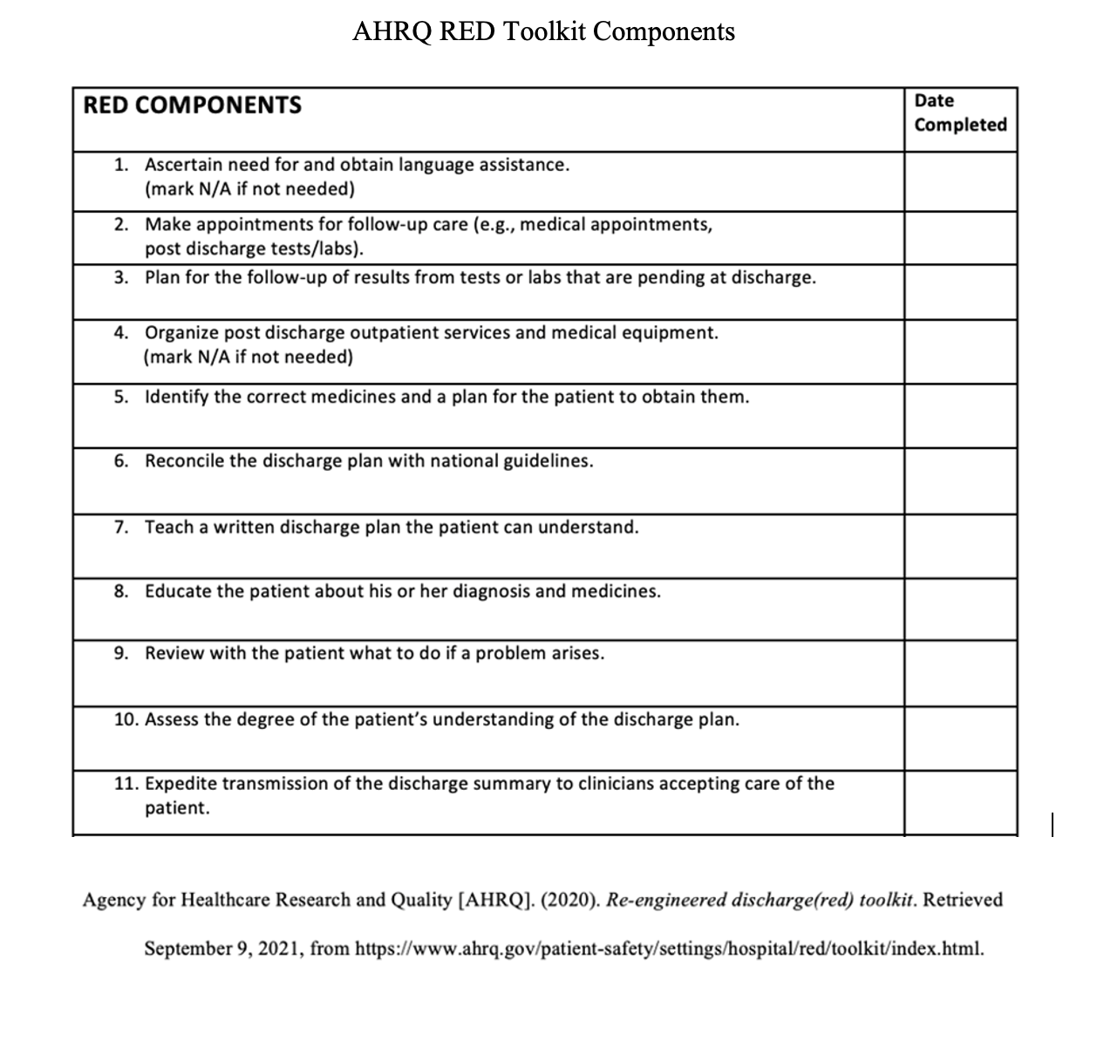
Instrumentation and Data Source
Data Source
Cerner EHR
Instrument
AHRQ toolkit
Validity
AHRQ (2020) verifies toolkit validity
Reliability
Health Information Technology IT Certification
(Cerner, 2021)
Notes:
Upon admission, the lead nurse determined if a patient admitted to the unit met the inclusion criteria and if so, this RED Toolkit checklist was attached to the whiteboard with a coversheet in the patient’s room. On the checklist, the nurse also notated demographic data, including age, diagnosis category, race, living status (alone or not alone), and gender, which were gathered from the EHR. Throughout the patient's stay and during the discharge process, the nurse notated when each component of the checklist was completed, if applicable. When the patient was discharged, the nurse placed the completed checklist in a locked box in a locked cabinet in the manager’s office. Only the project manager had access to the checklists once they were submitted.
The project manager collected the checklists weekly and input the data into an Excel spreadsheet on a password-locked computer at the site. Once the data from the checklist were transcribed, the checklist was placed back into the locked cabinet in a separate bin. After the patient was discharged, the quality director was able to track the patient for readmission over 60 days through a filtering system. Readmission data was also documented on the Excel spreadsheet to prepare for analysis.
It is important to assess the validity and reliability of data sources and instruments to ensure effective implementation. Numerous studies have utilized the toolkit, and the AHRQ verifies that the toolkit is valid and reliable (AHRQ, 2020). The project site used Cerner (2021), which is an EHR that has undergone the Health Information Technology (HIT) Health IT Certification Program; this program uses real-world testing to address all certification criteria and care settings. This certification is a requirement that is used to regulate the validity and reliability of the EHR (Cerner, 2021).

Slide 13
Bias and ethical considerations
Potential bias
Selection bias
Convenience Sampling
Non-response bias
Ethical considerations
Belmont Report
Justice, respect, beneficence
This project was reviewed by the Institutional Review Board at Grand Canyon University and was determined not to be human subjects research
Notes:
There are potential biases that may have impacted project implementation. The project used a convenience sample to create the intervention group. Convenience sampling is associated with selection bias and may decrease the ability to generalize project results to the population (Kaban & Posnick, 2021). Due to the nature of the project, a true random sample was not feasible, but it was important to choose patients with varying risks of readmission.
This project required both staff and patient participation. Non-response bias occurs when individuals selected for the sample do not participate in the intervention (Schmidt & Brown, 2017). If the staff or patient did not fully complete the toolkit, non-response bias would have minimized the data sample. During education, it was emphasized that the 11 components must be complete to produce effective data. In addition, staff was encouraged to participate by providing input about the implementation process as a way to increase participation.
This project protected the rights of the patient and staff during implementation and data collection. The Belmont Report focuses on guiding principles including justice, respect, and beneficence (Schmidt & Brown, 2017). Under these guidelines, each patient selected for implementation had a fair chance of receiving discharge under all of the components to promote the best outcomes. In the comparative phase, the lead nurses were educated that all patients who were 18 years or older and admitted to the unit were to be included in implementation. Moreover, it was made an expectation that all 11 components were to be completed to the fullest extent for each patient, ensuring that all patients in the intervention group received discharge following the standardized checklist. This project was reviewed by the Institutional Review Board at Grand Canyon University and was determined not to be human subjects research

Slide 14
Data analysis
Data analysis procedure
Analyzed in SPSS by a statistician
Data cleansing
Coding into the data dictionary
Nonparametric testing
Chi-square analysis
Nominal independent and dependent variable (Sylvia & Terhaar, 2018)
Statistical significance p < .05
Notes:
Data from the comparative and intervention groups were analyzed in IBM SPSS by a statistician. The statistician also helped in data cleansing to identify missing data and outliers. Demographic and readmission data from the comparative group were obtained from the Quality Director at the site and entered into an Excel spreadsheet by the project manager. Data from the intervention group were taken from the RED checklists and EHR and coded into a secure password-locked computer at the site by the project manager. Demographic data for both groups included age, gender, race, admit diagnosis, and living status (alone or not alone). The independent variable was the RED toolkit, and the dependent variable was readmission rates. In SPSS, the independent variable was entered as a 1 or 2, indicating if the patient received or did not receive the toolkit, respectively. Similarly, a 1 was documented if a patient was not readmitted and a 2 was documented if they were. The age of each patient was entered as the actual value and analyzed as scale data. Gender race, living status, and admit diagnosis were analyzed through frequencies as nominal data and coded with a numerical value. For example, gender was entered as a 1 for males and 2 for females. The demographic data were used to characterize the sample and identify outliers. Nonparametric testing was used to determine a relationship between the RED Toolkit and 60-day readmission rates.
In order to answer the clinical question, two nominal variables with yes or no answers were used: (1) did the patient receive the RED toolkit? and (2) was the patient readmitted? A chi-square is a type of nonparametric test that analyzes differences in two groups before and after implementation with a nominal independent and dependent variable (Sylvia & Terhaar, 2018). In this project, these groups included the comparative and intervention group and both variables were nominal. For this reason, a chi-square was the most appropriate test to answer the clinical question. The test aligned with the project design because this project asked if there was a change in readmission rates (nominal variable) after the implementation of the RED Toolkit (nominal variable). Statistical significance was set at p < .05 (Sylvia & Terhaar, 2018).

Slide 15
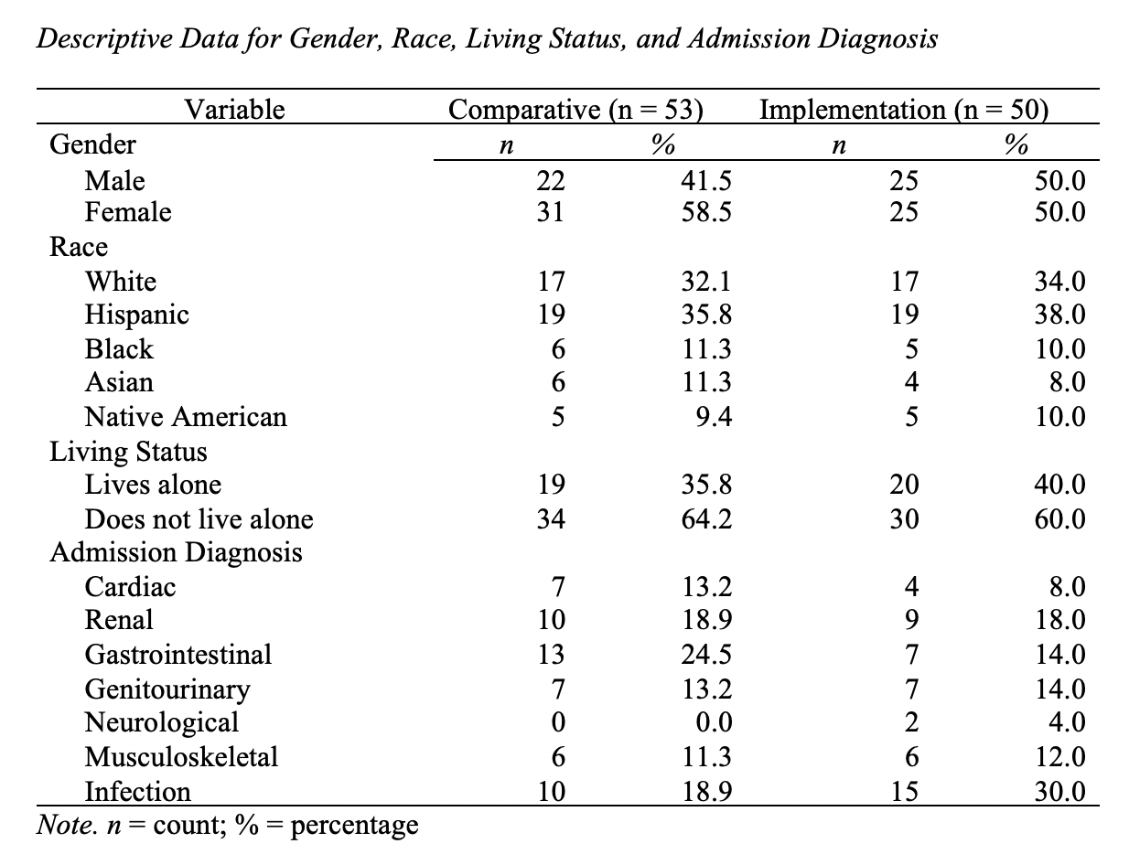
Descriptive data-sample population
Notes:
During the project, demographic data were collected on both the comparative and intervention groups to make observations on the sample’s characteristics. There were N = 103 patients sampled, n = 53 in the comparative group and n = 50 in the intervention group. The mean age of the comparative sample was 63.66 (SD = 14.93) with a range from 35 to 88. The implementation group had a mean age of 63.42 (SD = 13.69) with a range from 35 to 89.
Demographic data for gender, race, living status, and admission diagnosis are displayed in Table on the right. Males made up 41.5% of the comparative group and 50.0% of the implementation group. Females were 58.5% of the comparative group and 50.0% of the implementation group. The comparative group was 32.1% White, and the implementation group was 34.0% White. Hispanics made up 35.8% of the comparative group, and 38% of the implementation group. The comparative group was 11.3% Black, and the implementation group was 10.0% Black. Asians were 11.3% of the comparative group, and 8.0% of the implementation group. Native Americans made up 9.4% of the comparative group, and 10.0% of the implementation group. In the comparative group, 35.8% of the participants lived alone, and 64.2% did not live alone. In the implementation group, 40.0% of the participants lived alone, and 60.0% did not live alone. In the comparative group, admitting diagnoses included cardiac (13.2%), renal (18.9%), GI (24.5%), genitourinary (13.2%), musculoskeletal (11.3%), and infection (18.9%). In the implementation group, admitting diagnoses included cardiac (8.0%), renal (18.0%), GI (14.0%), genitourinary (14.0%), neurological (4.0%), musculoskeletal (12.0%), and infection (30.0%).

Slide 16
results
Notes:
Quantitative analysis was used to answer the clinical question and determine if there was a relationship between the RED Toolkit and readmission rates. The nonparametric chi-square was used to analyze the impact of the toolkit on 60-day readmission rates. Data on if the toolkit was provided and if the patient was readmitted) were compared between the comparative and implementation groups. The goal was to reduce readmissions. A chi-square test was performed, and the results showed a clinically and statistically significant difference between the comparative group readmission rate and implementation group readmission rate X² (1, N = 103) = 4.95 p = .026. The p-value is less than .05, which is statistically significant. Clinical significance was supported by the 9.4% reduction in readmission after the RED Toolkit was implemented.

Slide 17
Interpretation of Findings
Alignment with previous works
Decrease in readmission rates
Project: 9.4 % decrease
Patel and Dickerson (2017): 10% decrease
Smaller sample size
Cui et al. (2019) vs. McWilliams et al. (2018)
Teach back component
Oh et al. (2019) reinforces need for education
Home support
Notes:
The project results align with the findings from previous literature. For example, Patel and Dickerson (2017) used a similar pre- and post-test design and found a 10% decrease in readmissions, while this project showed a 9.4% decrease. The closeness of results is most likely attributed to the similarity in patient populations and project methodology, but it does support the efficacy of the RED Toolkit. Cui et al. (2019) conducted a randomized control trial and had a smaller sample size—similar to this project—and also achieved a statistically significant difference in readmission rates (p = 0.036). Other literature using the RED Toolkit has demonstrated the intervention’s clinical significance, but statistical significance is more often reached when utilizing a smaller sample. For example, McWilliams et al. (2018) had a larger sample size of patients (n = 1,876), and although a clinically significant 2% (p = 0.52) decrease in readmissions was found, this change was not statistically significant.
The implementation of this project relied heavily on nurses and teach-back, but other components of the toolkit, including follow-up care and needs assessments, were also employed. Oh et al. (2019) only implemented the teach-back portion of the toolkit and achieved statistically significant results (p = 0.02), which may suggest teach-back is one of the more important components of the toolkit. Demographic data also showed that there was a high percentage of patients in the comparative group who lived alone (35.0%). In their study on transitional services, McWilliams et al. (2018) determined that patients who lack support when transitioning home are at higher risk for readmissions.

Slide 18
Strengths and limitations
Project strengths
Use of Lewin’s model incentivized change
Real-time feedback
Unit culture
Project limitations
Staffing and feasibility
Misconceptions about workload
Influx of new staff
Notes:
There were several strengths that aided in the successful implementation of this project. The use of an evidence-based change model and theory in the creation of the design helped to overcome barriers to and ensure staff participation. Using Lewin’s (1947) change management model, allowed the project manager and unit manager to incentivize and increase acceptance of the project. During the educational session, staff was encouraged to ask questions and provide real-time feedback to ensure smooth facilitation of the change. Continuing education through handouts provided during daily huddles also helped to remind staff to follow the checklist and implement the toolkit. The floor culture and willingness to participate also attributed to the successful use of the toolkit. The nurses were interested in the project and the highly interdisciplinary nature of the unit was in alignment with the toolkit and goals of the project.
There were some limitations, however. Due to changes in staffing and feasibility at the site, the telephone follow-up component of the checklist was not incorporated into the quality improvement project. Prior to implementation, some nurses anecdotally reported concerns about the checklist increasing their workload. In order to overcome this barrier, the education sessions included a discussion on the distribution of roles. By the time the project was implemented, perceptions of increased workload were less of a concern and did not end up being a barrier to implementation.
Another limitation was the influx of new staff during the implementation period. Many new nurses and travel nurses started working on the unit after the initial education session. Daily huddle handouts were disseminated to keep staff up-to-date on the intervention and ensure project compliance. Lastly, the project site had certain restrictions and would only allow the project to be piloted on one unit. Although this factor decreased the original expected sample size, there was still an ample amount of data for analysis.

Slide 19
implications
Theoretical Implications
Effective results support the use of Orem’s theory and Lewin’s model
Independence, collaboration, active participation
Nursing Practice Implications
Predicting high-risk patients
Allocation of resources
Organization and consistency
Notes:
The nursing theory that guided this project was Orem’s self-care deficit theory. The RED Toolkit components include post-discharge services, understanding patients’ health needs, and requirements for managing health post-hospitalization. The components of the RED Toolkit aligned with Orem’s (1971) principles of providing help, utilizing education, and identifying self-care needs to improve patient outcomes. In other words, the clinically and statistically significant results of this project support the use of nursing theories that focus on prioritizing patient independence.
In addition, Lewin’s change management model was used to guide the project’s implementation. Lewin’s (1947) recommended following the stages of unfreezing, changing, and refreezing in order to engage change agents in planning and gain support for effective implementation. Due to this framework, the project was well-implemented on the unit. Data showed good compliance with each component of the toolkit, and staff anecdotally reported that they understood the expectations of intervention. Using standardized models for education and planning also helped decrease resistance to change, making staff eager to implement the toolkit. The results showed that the intervention group had a 9.4% lower readmission rate than the comparative group. The positive results show the importance of gaining change agent support before beginning quality improvement efforts.
The results of the project also show that prioritizing patient independence, interdisciplinary collaboration, and change agent participation leads to effective results. Developing new theories that follow these principles may help create effective quality improvement efforts in the future.
The results of this project show that the RED Toolkit has the potential to improve patient outcomes. The demographic data can help in predicting patients at higher risk for readmission. For example, demographics showed that patients who live alone and have more complex diagnoses are more likely to be readmitted within 60 days. With this information, nurses and care management teams can better allocate discharge resources to these patients. In addition, nurses at the site anecdotally reported that the checklist aided in the organization and continuity of the discharge process. The lead nurses documented when a task was completed, which communicated to the rest of the care team that another component could be focused on. The checklist allowed the lead nurse to know what tasks still needed to be completed from shift-to-shift, which improved patient care. The positive results of this project reinforce the need for interdisciplinary care throughout a patient’s stay—not just during discharge. The results of this project can alter the workflow of nursing practice and influence an increased emphasis on patient and provider communication

Slide 20
Recommendations-future projects
Larger sample size
Include numerous units
Increase implementation timeframe
Six months instead of eight weeks
Toolkit compliance
Electronic checklist
Increase ease of use
Add the follow-up phone call
Notes:
The first recommendation for future projects is to increase the sample size. A larger sample size would aid in representing a larger part of the total population. In the review of literature and within this project, smaller sample sizes showed more statistical significance; it would be helpful to see if the toolkit is effective on larger groups of patients. Instead of implementing the project on only one medical surgical unit, multiple units with varying specialties could be included. A larger sample would advance healthcare outcomes by establishing if the RED Toolkit interventions achieve consistent results across various populations.
Another recommendation is to increase the implementation timeframe. This project was implemented in eight weeks. A longer implementation time would have provided more accurate data and lessened the possibility for bias. This project would be a quasi-experimental design with a quantitative methodology, examining readmission rates before and after implementation. Data could be collected after six months and would include readmission data, demographics and checklist data. An extended project would better demonstrate the relationship between the RED Toolkit and readmission rates.
A future project could also examine compliance with completing the RED Toolkit. In addition to monitoring readmission rates, data could also be collected on the components of the toolkit that were missed most frequently. Nurses would document which components of the toolkit they completed with the patient and which components were not completed. This project would analyze the compliance with the use of the toolkit and if compliance with the toolkit impacted which patients were readmitted. These findings would provide insight into which discharge steps need remediation.
Future projects could incorporate the checklist into the EHR charting system instead of using a paper checklist. This process would improve ease of use, provide better documentation, and aid in overall data collection. If the RED Toolkit was embedded in the discharge flowsheet at the end of the hospital stay, then nurses may more easily remember to complete the components. The electronic checklist would be continually modified and at the time of discharge would be signed into the chart by the lead nurse.
The last recommendation is to add the discharge follow-up phone call to future projects. The project focused on 11 out of the 12 components due to feasibility and staffing at the site. The integration of the phone call would add continuity to the discharge process and may aid in providing even better results related to readmissions.

Slide 21
Recommendations-Sustainability
Continuing education
New nurse orientation
Learning modules
Regular audits and performance boards
Discussion during huddle
Compliance rates
Incorporation of state and national goals
Notes:
An important part of change is ensuring effective methods that support sustainability of effective quality improvement efforts. The first sustainability plan is to perform continuing education during new nurse orientation, professional development learning modules, and frequent discussion of the toolkit at all staff meetings. This sustainability plan will require continual staff participation, which will ensure that they continue to be excited about the intervention and its effects on patients. Exposing new staff to the toolkit and reminding current staff of its impact will ensure the checklist is being used at discharge.
Another option for sustainability would be to perform regular audits and use performance boards. Managers and team leads could track the use of the toolkit among the patients and publish compliance percentages within the unit. Establishing a target goal for toolkit use could help staff realize the expectation of that the project be followed. Incorporating state and national goals into these processes could help to incentivize change and ensure its sustainability.

Slide 22
Additional Plans for Dissemination
On-site dissemination
PowerPoint during staff meetings
EBP committee and Director of Nursing
Other dissemination opportunities
American Nurses Association blog
State board meetings
Nurse symposiums
ProQuest or the Journal for Doctoral Dissertation
Notes:
The project results will be disseminated at the site during a staff meeting using a PowerPoint with diagrams. This meeting is open to other unit managers, which could potentially further the adoption of the toolkit across the organization. The results will also be presented to the evidence-based practice committee and the Director of Nursing. The findings will be disseminated informally at a monthly teleconference.
A PowerPoint, approved by the site, will also be posted on the American Nurses Association blog to reach a broader audience of medical professionals. The presentation will include a brief explanation of the background, project methodology, and results. This method of presenting the results will allows for feedback and further discussion of the project. The findings may also be presented at state board meetings and regional nurse symposiums. The finalized manuscript could also be published in ProQuest or the Journal for Doctoral Dissertation.

Slide 23
References
Agency for Healthcare Research and Quality [AHRQ]. (2020). Re-engineered discharge (red) toolkit. Retrieved September 9, 2021, from https://www.ahrq.gov/patient-safety/settings/hospital/red/toolkit/index.html.
Agency for Healthcare Research and Quality [AHRQ]. (2021). Overview of clinical conditions with frequent and costly hospital readmissions. Retrieved July 5, 2022, from https://www.hcup-us.ahrq.gov/reports/statbriefs/sb278-Conditions-Frequent-Readmissions-ByPayer2018.jsp#:~:text=Data%20are%20provided%20in%20Supplemental,average%20readmission%20cost%20of%20%2415%2C200.
Arizona Department of Health Services. (2021). Public health statistics – hospital discharge data. Retrieved July 5, 2022, from https://www.azdhs.gov/preparedness/public-health-statistics/hospital-discharge-data/index.php
Cerner. (2021). Certified health it. Retrieved March 28, 2023, from https://www.cerner.com/certified-health-it
Cuellar De la Cruz, Y., & Robinson, S. (2017). Answering the call to accessible quality health care for all using a new model of local community not-for-profit charity clinics: A return to Christ-centered care of the past. The Linacre quarterly, 84(1), 44–56. https://doi.org/10.1080/00243639.2016.1274631
Cui, X., Zhou, X., Ma, L.-le, Sun, T.-W., Bishop, L., Gardiner, F., & Wang, L. (2019). A nurse-led structured education program improves self-management skills and reduces hospital readmissions in patients with chronic heart failure: A randomized and controlled trial in China. Rural and Remote Health. https://doi.org/10.22605/rrh5270

Slide 24
References
Gai, Y., & Pachamanova, D. (2019). Impact of the medicare hospital readmissions reduction program on vulnerable populations. BMC Health Services Research, 19(1). https://doi.org/10.1186/s12913-019-4645-5
Lewin, K. (1947). Frontiers in group dynamics: concept, method and reality in social science; social equilibria and social change. Human Relations, 1, 5–41. https://doi.org/10.1177/001872674700100103
McWilliams, A., Roberge, J., Anderson, W. E., Moore, C. G., Rossman, W., Murphy, S., McCall, S., Brown, R., Carpenter, S., Rissmiller, S., & Furney, S. (2018). Aiming to improve readmissions through integrated hospital transitions: A pragmatic randomized controlled trial. Journal of General Internal Medicine, 34(1), 58–64. https://doi.org/10.1007/s11606-018-4617-1
Odeh, M., Scullin, C., Fleming, G., Scott, M. G., Horne, R., & McElnay, J. C. (2019). Ensuring continuity of patient care across the healthcare interface: Planning follow‐up post‐hospitalization. British Journal of Clinical Pharmacology, 85(3), 616–625. https://doi.org/10.1111/bcp.13839
Oh, E. G., Lee, H. J., Yang, Y. L., & Kim, Y. M. (2019). Effectiveness of discharge education with the teach-back method on 30-Day readmission: A systematic review. Journal of Patient Safety, 17(4), 305–310. https://doi.org/10.1097/pts.0000000000000596
Orem, D. E. (1971). Nursing concepts of Practice (5th ed.). Mosby.
Patel, P. H., & Dickerson, K. W. (2017). Impact of the implementation of project reengineered discharge for heart failure patients at a veteran’s affairs hospital at the central Arkansas veterans’ healthcare system. Hospital Pharmacy, 53(4), 266–271. https://doi.org/10.1177/0018578717749925

Slide 25
References
Project site. (2022).
Sylvia, M. L., & Terhaar, M. F. (2018). Clinical analytics and data management for the DNP (2nd ed.). New York, NY: Springer Publishing Company.
Wang, Y., Eldridge, N., Metersky, M. L., Rodrick, D., Faniel, C., Eckenrode, S., Mathew, J., Galusha, D. H., Tasimi, A., Ho, S.-Y., Jaser, L., Peterson, A., Normand, S.-L. T., & Krumholz, H. M. (2022). Analysis of hospital-level readmission rates and variation in adverse events among patients with pneumonia in the United States. JAMA Network Open, 5(5). https://doi.org/10.1001/jamanetworkopen.2022.14586
Yiadom, M. Y. A. B., Domenico, H., Byrne, D., Hasselblad, M. M., Gatto, C. L., Kripalani, S., Choma, N., Tucker, S., Wang, L., Bhatia, M. C., Morrison, J., Harrell, F. E., Hartert, T., & Bernard, G. (2018). Randomized controlled pragmatic clinical trial evaluating the effectiveness of a discharge planning on 30-day hospital readmissions: balancing pragmatic and explanatory design considerations. BMJ Open, 8(2), https://lopes.idm.oclc.org/login?url=https://search.ebscohost.com/login.aspx?direct=true&db=cmedm&AN=29444787&site=eds-live&scope=site&custid=s8333196&groupid=main&profile=eds1

